Slide 1
603 DEVELOPMENT PRESENTATION
Project Plan: Baseline, Actual Progress and Changes
01
Project plan evaluation for the final presentation
MILESTONE
ORIGINAL PLAN
ACTUAL PROGRESS AND REASON
Sprint 1 baseline
Plan: define the referral to treatment journey, assign pathway ownership and agree how the pathways depend on each other.
Progress: the group established the shared process architecture before each member developed their own pathway.
Sprint 2 and Release 1
Plan: connect forms, worker logic and gateway conditions so the separate pathways can run as one patient journey.
Progress: integration exposed where a user decision, a form value or a process path needed clearer control.
Actual Release 2
Change: tutor feedback moved validation, route merging, missing business choices and persistent patient data to the top priority.
Result: the final release supports safer input, clearer process flow and patient information that remains available after a worker restarts.
Plan changed: after initial integration, we prioritised the issues that decide whether a patient journey can run safely. Valid form input comes first, then alternative paths rejoin cleanly, then the system keeps patient data after a restart. This order keeps human choices under control and gives later tasks the information they need.

Slide 2
603 DEVELOPMENT PRESENTATION
Test Plan and Acceptance Criteria
02
What the test plan checks before the live demonstration
Purpose
The test plan proves that the hospital workflow accepts valid information, handles business exceptions safely, and preserves the patient record for later work.
AREA
SCENARIO WE TEST
PASS CONDITION
Referral
Complete or missing information, valid reference, accept, reject, redirect
The route reaches consultant review or the correct missing-information / decision path.
Appointment
Suitable slot, no slot, appointment within 14 days, contact outcome
The process records the outcome and asks for a revised request or telephone contact when required.
Treatment
Consent, unauthorised request, unavailable resource, clinical decision
Only authorised treatment proceeds. Unavailable resources create a controlled pending or retry route.
Funding and payment
Funding route, successful or declined payment, confirmation loss, refund approval
The process avoids automatic recharging and only sends an approved refund to the refund worker.
Enquiry and clinic letter
Team routing, urgent clinical concern, approval, delay and age-band escalation
The process sends work to the right team and never distributes an unapproved clinic letter.
Technical checks
BPMN / form / worker linkage, worker behaviour, persistence and deployment
Every binding resolves, worker outputs update variables, and patient data can be retrieved by patient ID.
Acceptance decision: configuration, worker logic, persistence and deployment must pass first. The live demonstration then shows one normal journey and one exception / retry journey in Tasklist, including the submitted decision and the resulting BPMN path.

Slide 3
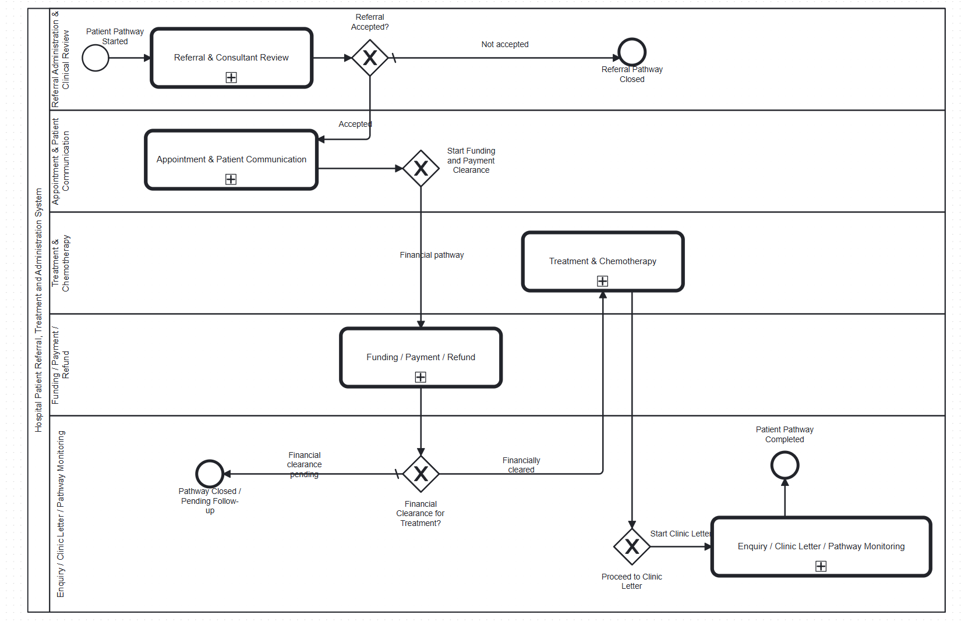
603 DEVELOPMENT PRESENTATION
Hospital Master BPMN
03
1. The master process coordinates referral, appointment, finance, treatment, and clinic-letter work as one patient journey.
2. A positive decision in one area creates the data and control needed by the next area.
3. Human decisions stay in forms. Automated checks run through Camunda workers.
4. This integrated design prevents a treatment activity from starting before relevant referral, appointment and financial decisions are available.

Slide 4
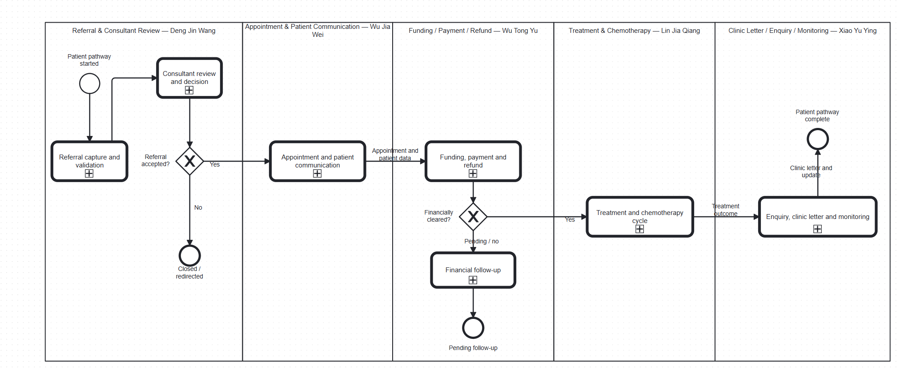
603 DEVELOPMENT PRESENTATION
Strategic BPMN: The Hospital Pathway
04
1. The strategic view starts with a referral and moves through booking, funding, treatment and follow-up communication.
2. It shows why each operational process exists and where a patient depends on the next service.
3. The operational BPMN models implement these stages with tasks, gateways, forms and workers.

Slide 5
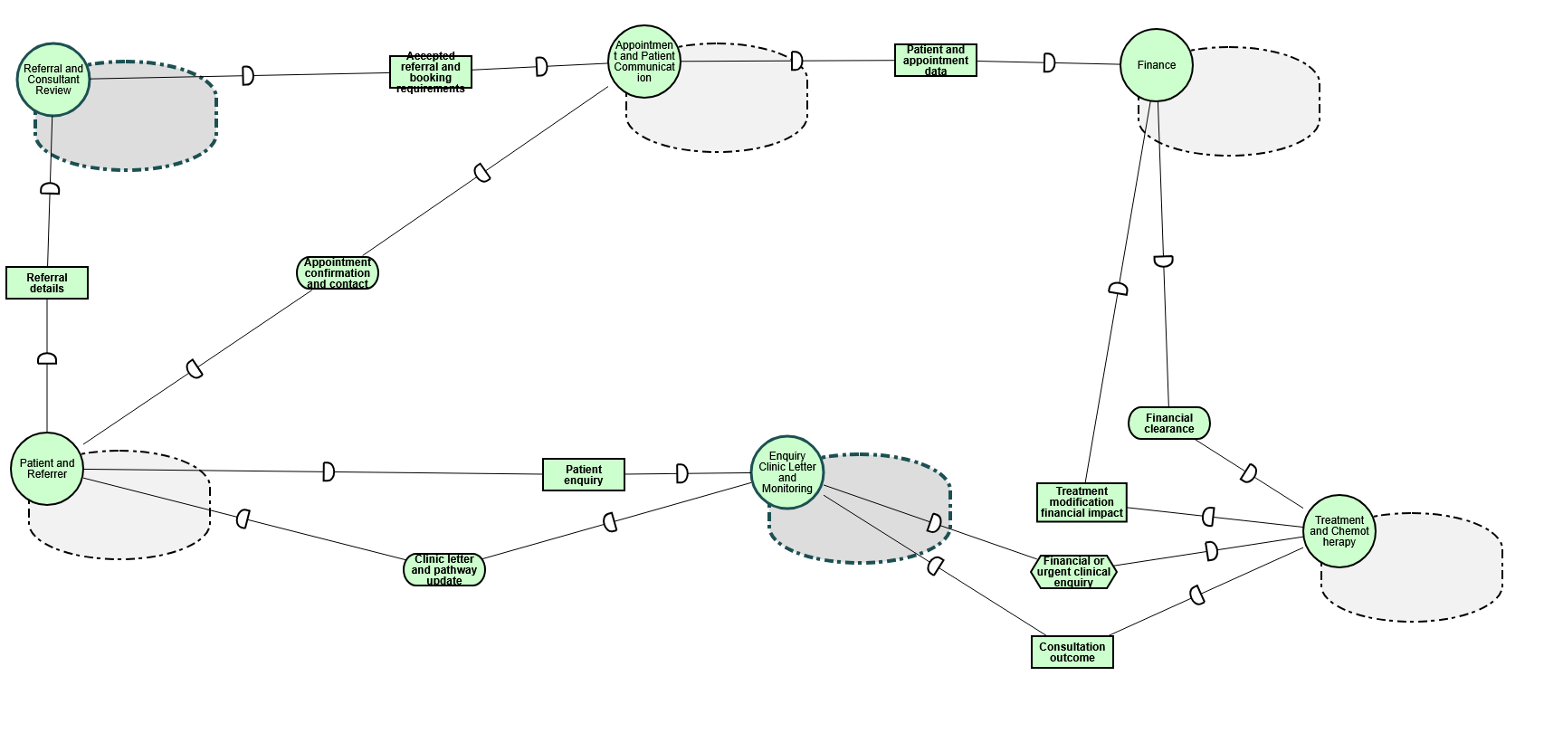
603 DEVELOPMENT PRESENTATION
Strategic Dependency Model: Who Depends on Whom
05
1. The SD model contains six actors: Patient and Referrer, Referral and Consultant Review, Appointment and Patient Communication, Finance, Treatment and Chemotherapy, and Enquiry Clinic Letter and Monitoring.
2. Dependencies make hand-offs visible. Examples include referral details, accepted referral and booking requirements, financial clearance, consultation outcome and clinic letter updates.
3. The SD model supports accountability because each dependency has a depender, a dependee and a concrete dependum.

Slide 6
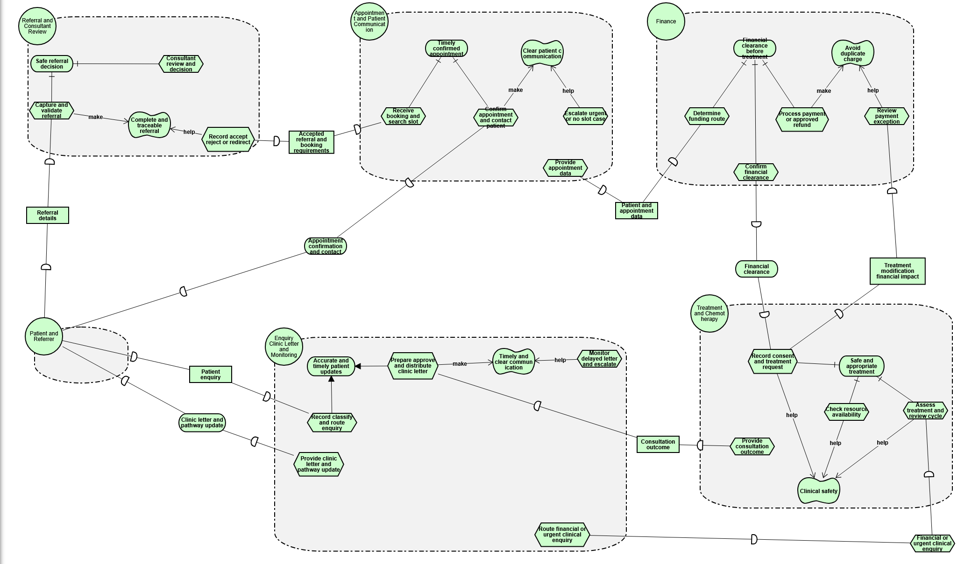
603 DEVELOPMENT PRESENTATION
Strategic Rationale Model: Goals and Decisions
06
1. The SR model explains why each actor performs its tasks.
2. Referral work supports a safe referral decision and complete, traceable referral.
3. Appointment work supports a timely confirmed appointment and clear patient communication. Finance supports financial clearance before treatment. Treatment supports clinical safety. Enquiry and letter work supports accurate, timely updates.
4. AND refinements show activities that must work together. OR refinements show alternative ways to achieve a goal.

Slide 7
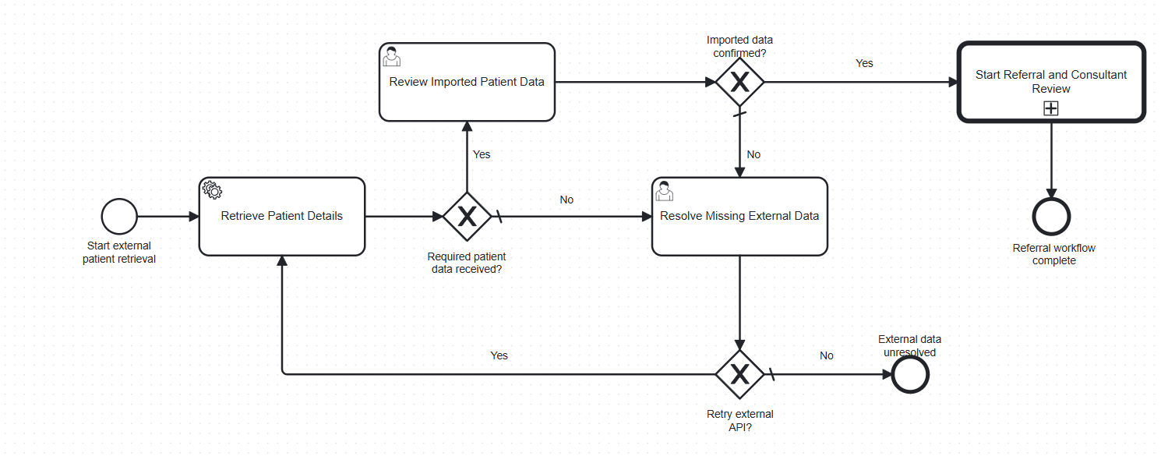
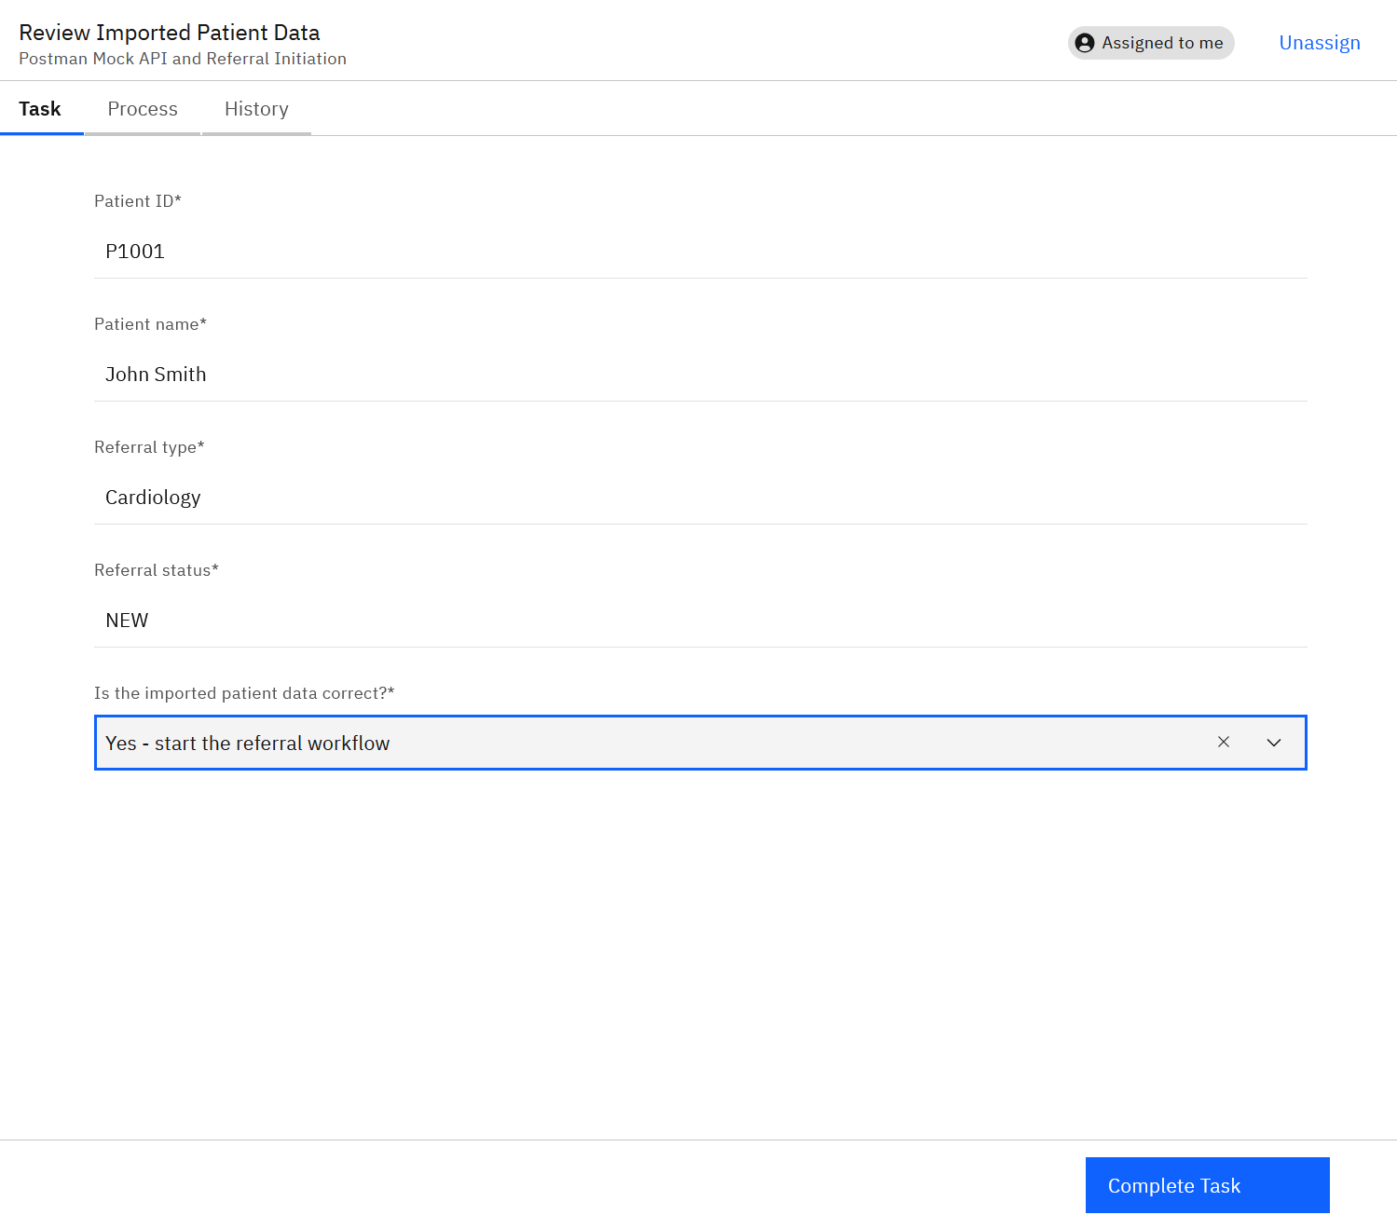
603 DEVELOPMENT PRESENTATION
Further Development: External API and Patient Confirmation
09
1. The local mock exposes GET /patients/next and returns one patient record for the BPMN route.
2. Retrieve Patient Details maps patientId, patientName, referralType and referralStatus into process variables.
3. The reviewer sees these values in Tasklist and actively chooses whether the imported data is correct. The XOR gateway only routes after this choice.
4. Update: the route was tested from API response to Tasklist confirmation, including a controlled missing-data branch.

Slide 8
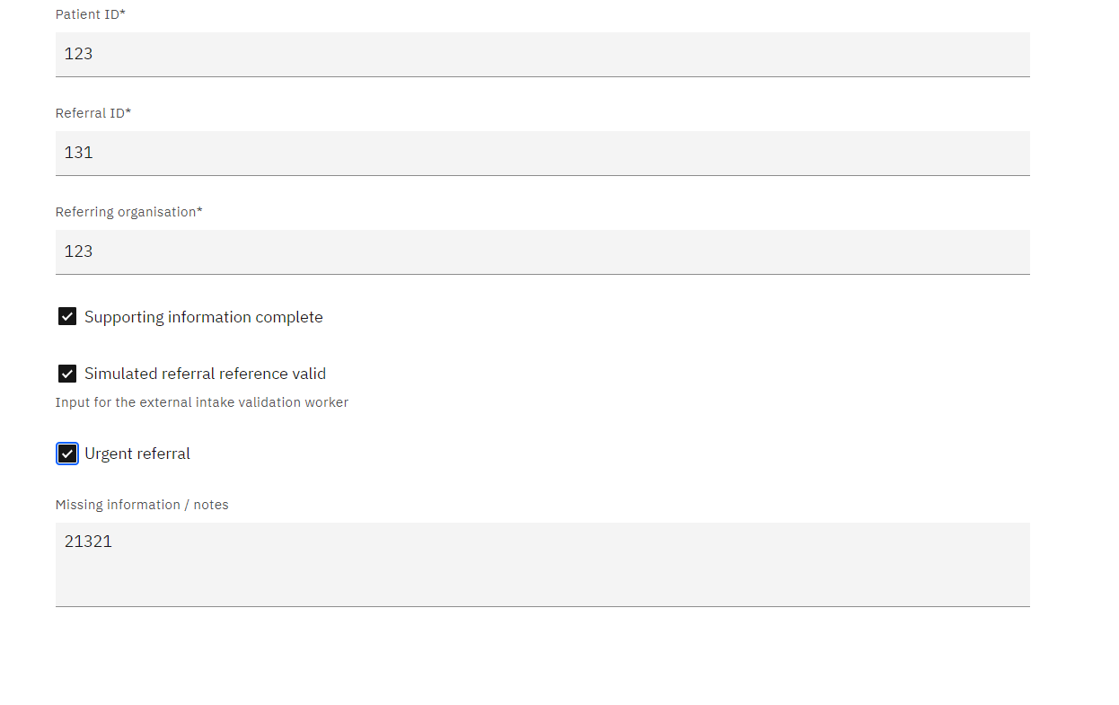
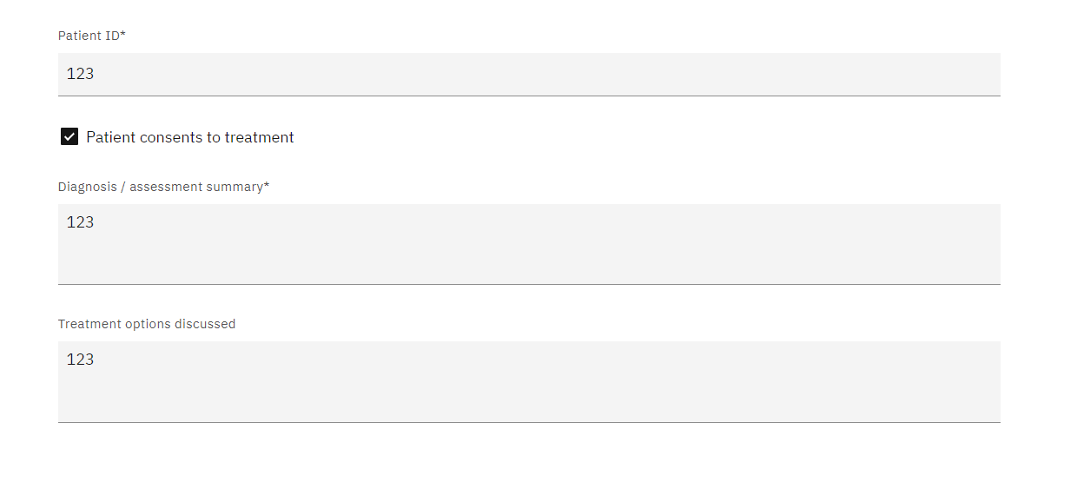
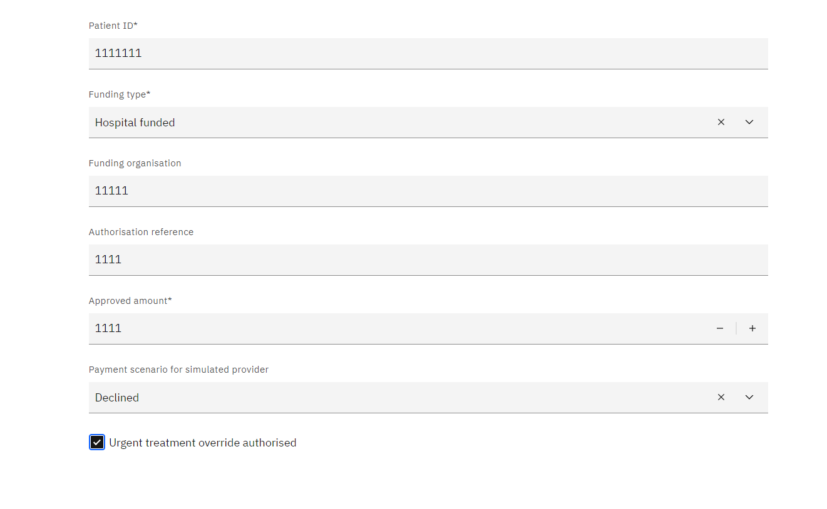
603 DEVELOPMENT PRESENTATION
Tasklist Evidence for Business Scenarios
15
Response to Feedback | Tasklist evidence
API integration BPMN: Review Imported Patient Data task, before the dataConfirmed gateway.
Referral BPMN: Check Supporting Information task, before the referral-validation decision.
Treatment BPMN: Record Patient Consent task, before the authorised treatment request.
Funding BPMN: Record Funding / Payment Details task, before funding and payment gateways.

Slide 9
603 DEVELOPMENT PRESENTATION
Technical Implementation: API to BPMN Decision
16
How the API actually works
Postman Mock
HTTP JSON
connector
BPMN variables
Tasklist confirmation
dataConfirmed
XOR gateway
The API does not choose Yes or No. It only supplies patient data. A user makes the choice in Tasklist, and the gateway follows the value submitted by the form.
The Mock API returns one BPMN-safe patient object. The HTTP connector stores the JSON fields as process variables. Tasklist then captures the human decision. The XOR gateway evaluates that decision.

Slide 10
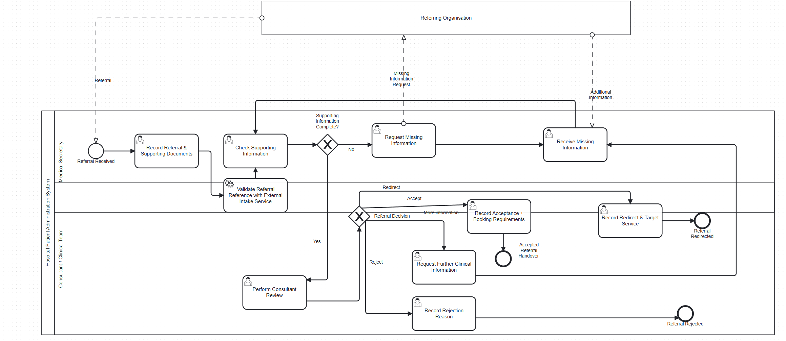
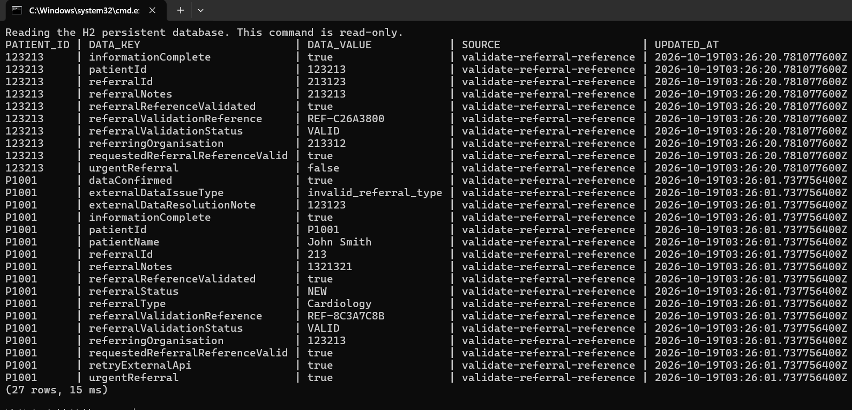
603 DEVELOPMENT PRESENTATION
Referral and Consultant Review
07
Further Development | Dengjinwang Deng
The referral and consultant-review route. The Validate Referral Reference worker checks the reference and writes the outcome by patientId.
H2 record written by Validate Referral Reference

Slide 11
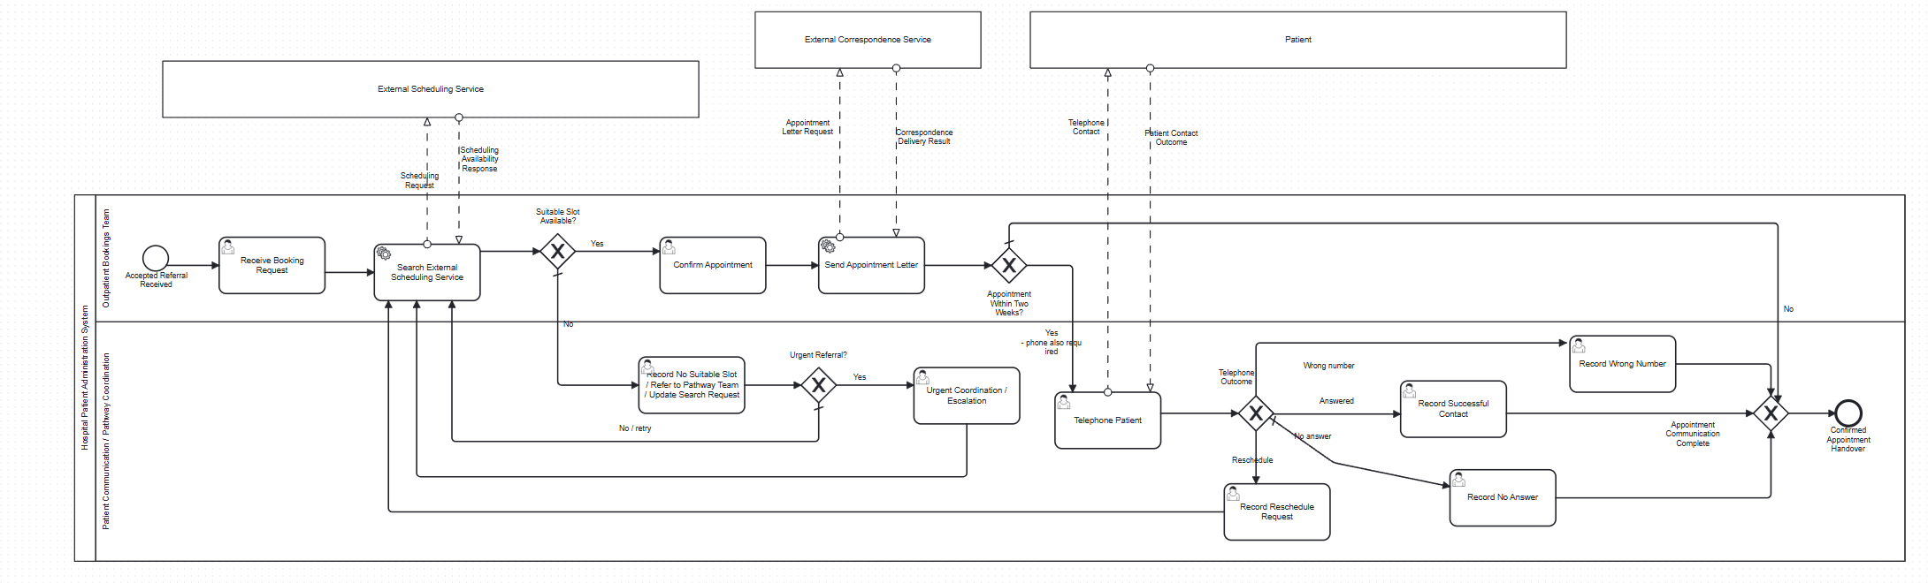
603 DEVELOPMENT PRESENTATION
Appointment
08
appointment confirmation and the patient-facing communication route. Explain how an appointment outcome becomes a controlled process decision.
update:Modelled and connected. The next action was to verify their forms and integration conditions.

Slide 12
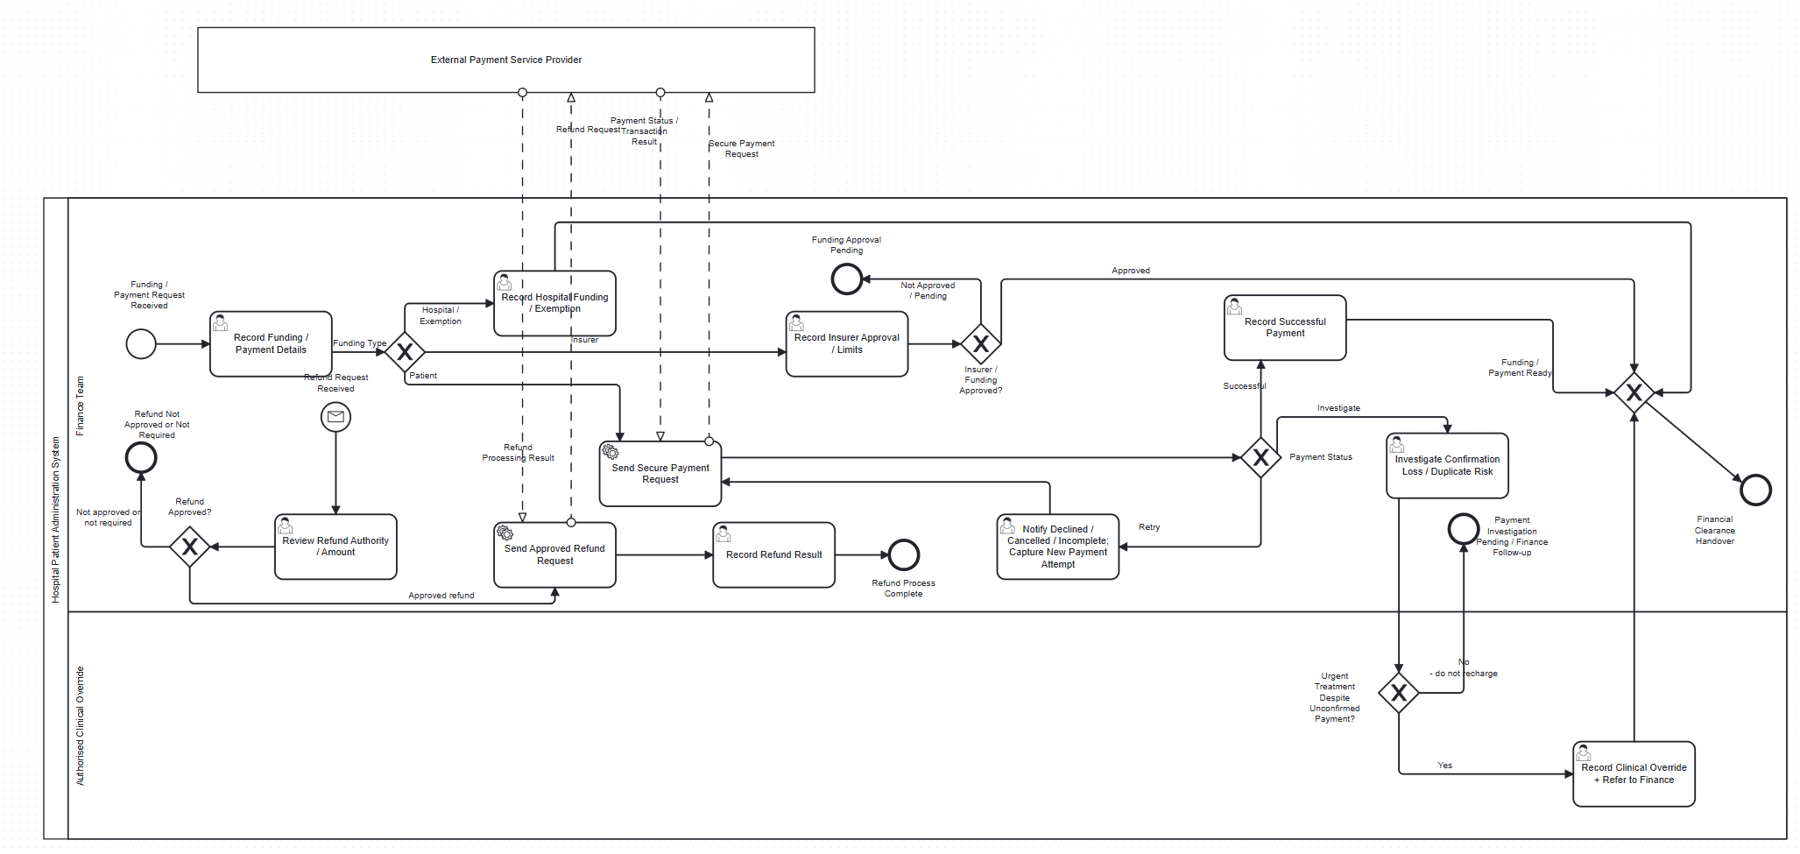
603 DEVELOPMENT PRESENTATION
Further Development: Funding, Payment and Refund
10
1. Wu Tongyu developed the Funding, Payment and Refund route.
2. The form captures funding type, organisation, approval reference and payment scenario.
3. The process branches to hospital, insurer or patient funding and uses a controlled retry task after a declined payment.
4. Confirmation loss is investigated rather than automatically charged again. A refund reaches the worker only after Finance approval.

Slide 13
603 DEVELOPMENT PRESENTATION
Teacher Feedback
11
Feedback point
Priority decision and planned action
Form validation
Require valid inputs and use controlled options for routing values.
Merging gateways
Remove duplicate downstream paths and converge alternatives safely.
Forms for scenarios
Provide normal, exception and retry decisions in Tasklist.
Data persistence
Keep application data after worker restart and retrieve it by patientId.

Slide 14
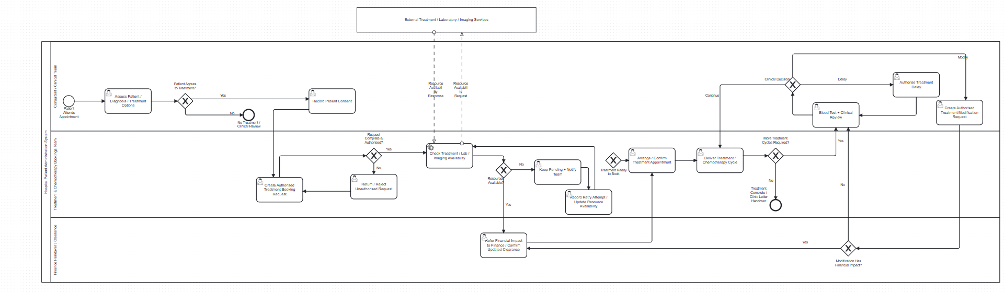
603 DEVELOPMENT PRESENTATION
Feedback Improvement: Clinical Form Validation
12
1. Lin Jiaqiang developed the treatment and chemotherapy route and strengthened clinical task validation.
2. Required patient, clinical, decision and outcome fields prevent a task from completing with missing values.
3. Controlled selections give gateways predictable values rather than relying on free text.
4. The improvement protects clinical safety because the process does not progress until required information is present.

Slide 15
603 DEVELOPMENT PRESENTATION
Feedback Improvement: Merging Gateways
13
1. A merging gateway brings alternative paths back into one controlled downstream path.
2. This prevents duplicated tasks after successful and corrected outcomes.
3. Release 2 uses named convergence points in Appointment, Finance, Treatment and Clinic Letter processes.
4. The appointment merge: separate booking outcomes converge before the shared notification or follow-up activity.

Slide 16
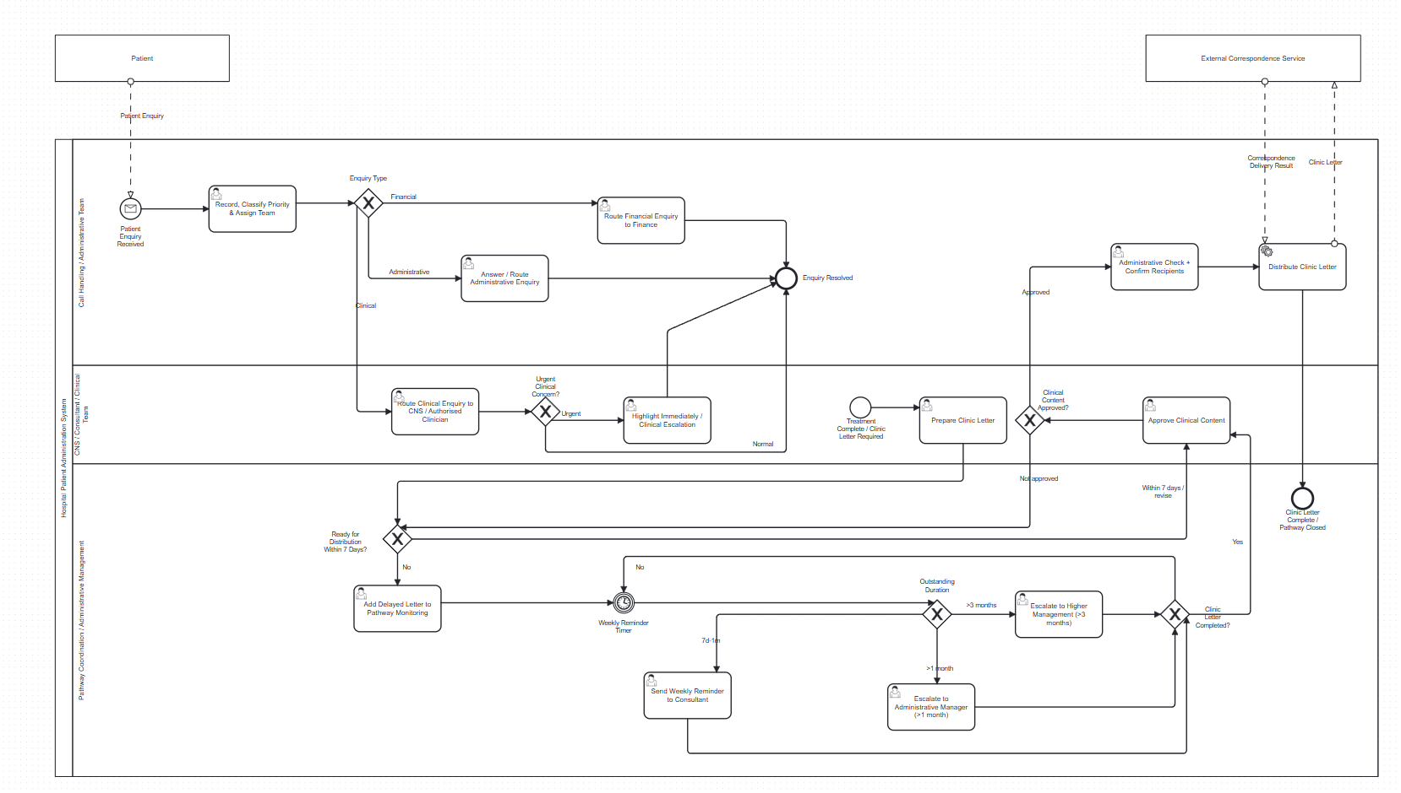
603 DEVELOPMENT PRESENTATION
Feedback Improvement: Forms for Business Scenarios
14
1. developed enquiry, clinic-letter and monitoring work.
2. The forms cover normal communication as well as delayed, missing or rejected information scenarios.
3. Each exception form captures the user decision needed to retry, escalate or end the route safely.
4. The forms turn business rules into visible and testable Tasklist behaviour.

